Slide 1
Name : N.Vignesh
Reg.no : 730321104061
NM id : au730321104061
Degree : B.E - CSE
Year : III
College name : Builders Engineering College
3/21/2024 Annual Review

Slide 2
PROJECT TITLE
Text to Image Synthesis
3/21/2024 Annual Review

Slide 3


AGENDA
Research and Dataset Collection.
Data Preprocessing.
Model Architecture Design.
Training Process.
Evaluation and Fine-tuning
Deployment and Integration
3/21/2024 Annual Review

Slide 4

PROBLEM STATEMENT
The Objective of this project is to Develop a Text-to-Image synthesis system using Generative Adversarial Networks (GANs) to generate realistic images based on textual descriptions. The system aims to bridge the semantic gap between textual and visual modalities, enabling applications such as image generation from textual prompts or assisting visually impaired individuals in understanding textual content through generated images. The challenge lies in training a GAN model capable of effectively translating textual descriptions into visually coherent and contextually relevant images, while ensuring diversity, realism, and semantic consistency in the generated outputs.
3/21/2024 Annual Review

Slide 5

PROJECT OVERVIEW
This project aims to develop a Text-to-Image synthesis system using Generative Adversarial Networks (GANs) to translate textual descriptions into realistic images.
The system will leverage deep learning techniques to train a GAN architecture capable of generating visually coherent images from textual input.
Key objectives include ensuring semantic consistency between text and image outputs, exploring diverse dataset sources for training, and evaluating the model's performance on quality and diversity metrics.
3/21/2024 Annual Review

Slide 6

WHO ARE THE END USERS?
Artists and Designers
Content Creators
Educators and Trainers
E-commerce Platforms
Virtual Reality and Gaming Developers
3/21/2024 Annual Review

Slide 7

YOUR SOLUTION AND ITS VALUE PROPOSITION
Solution:
Our solution involves developing a state-of-the-art Text-to-Image synthesis system using Generative Adversarial Networks (GANs). Through advanced deep learning techniques, our model will translate textual descriptions into visually coherent and contextually relevant images with high fidelity and diversity.
Value proposition:
Efficiency
Creativity and Innovation
Enhanced Communication
Customization and Adaptability
Accessibility
Scalability and Integration
3/21/2024 Annual Review

Slide 8

THE WOW IN YOUR SOLUTION
Our groundbreaking Text-to-Image synthesis solution harnesses the power of cutting-edge GAN technology to seamlessly transform textual descriptions into stunningly realistic and diverse images, revolutionizing creative expression and communication. With unparalleled accuracy and efficiency, our system empowers users to effortlessly bring their ideas to life in vivid detail, unlocking limitless possibilities across industries and applications.
3/21/2024 Annual Review
‹#›

Slide 9
MODELLING
Teams cam add wireframes
Home Page
Image Display Area
Settings Panel
History Log
Feedback Form
Download Option
About Section
3/21/2024 Annual Review
‹#›

Slide 10
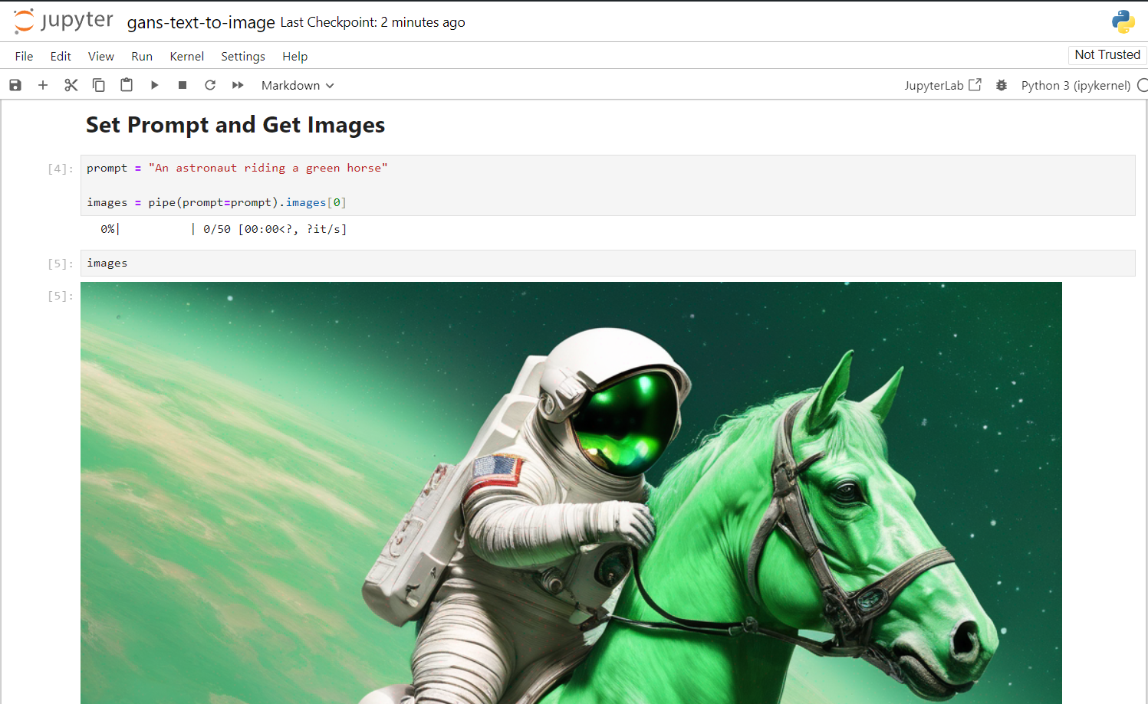
RESULTS
3/21/2024 Annual Review
‹#›

